Slide 1
Domain with Persistence or not
Domain classes with persistence knowledge or not?
Pure domain model
Active record

Slide 2
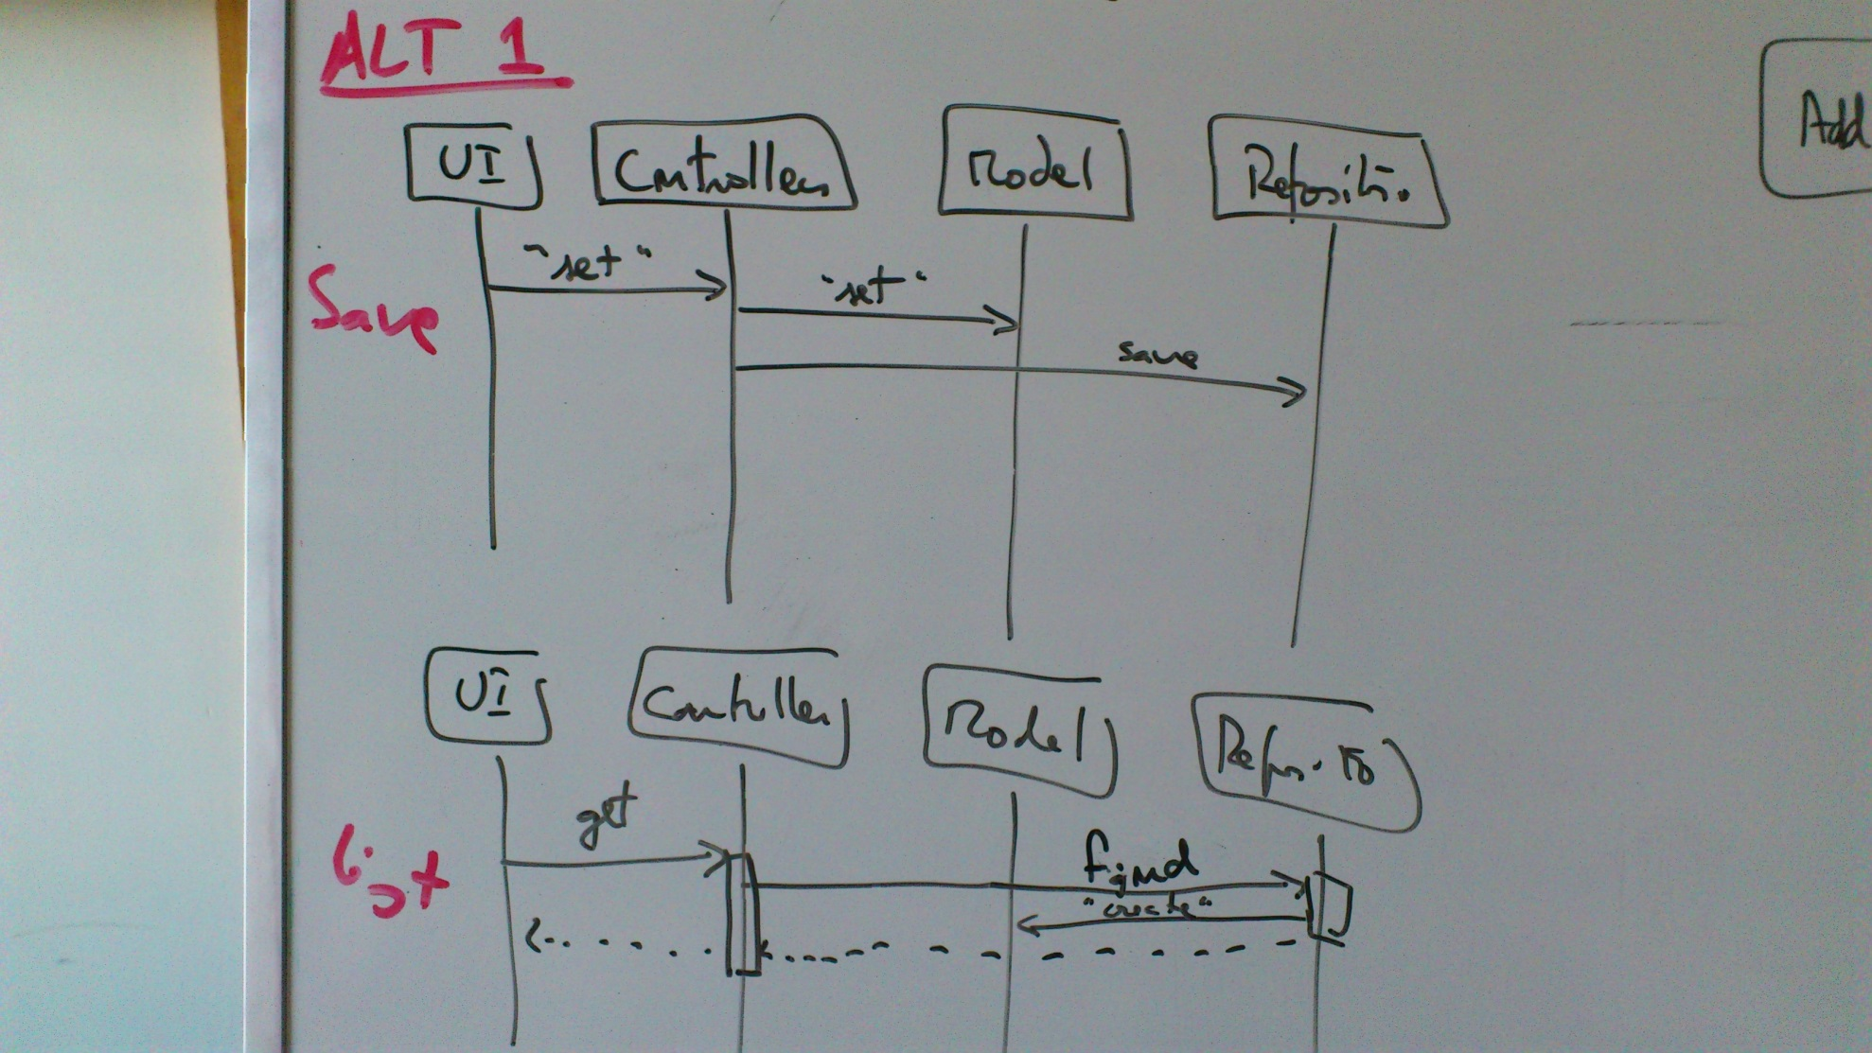
Domain model

Slide 3
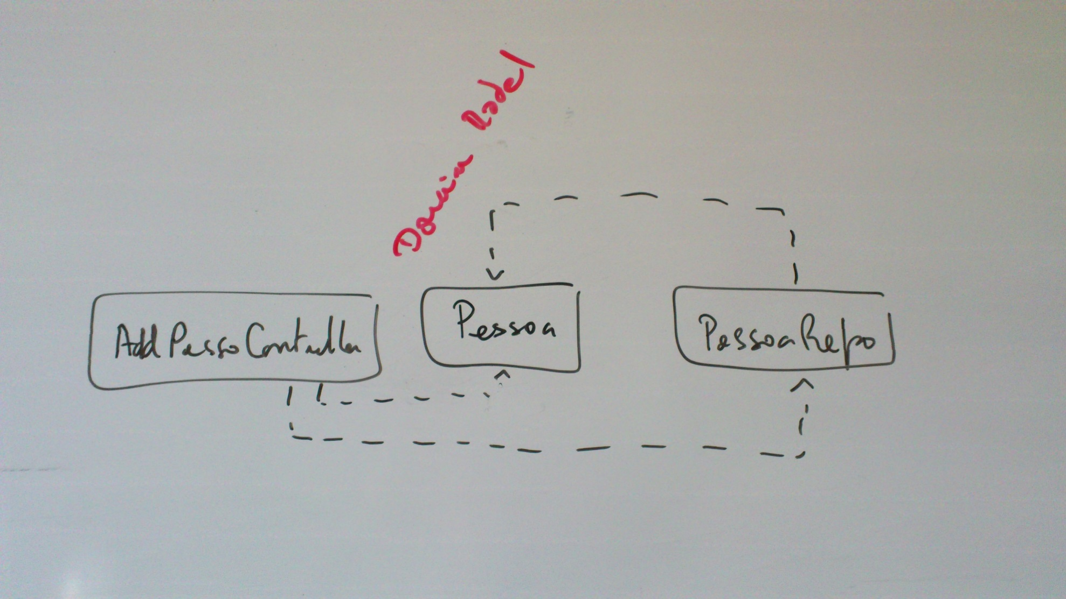
Domain model

Slide 4
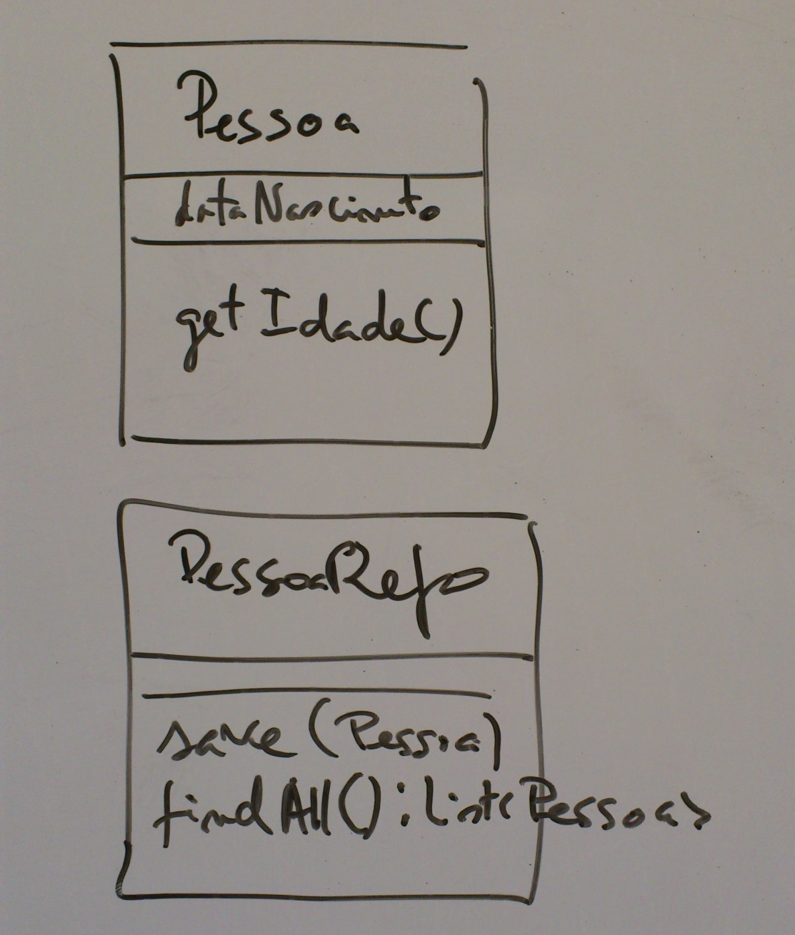
Domain model

Slide 5
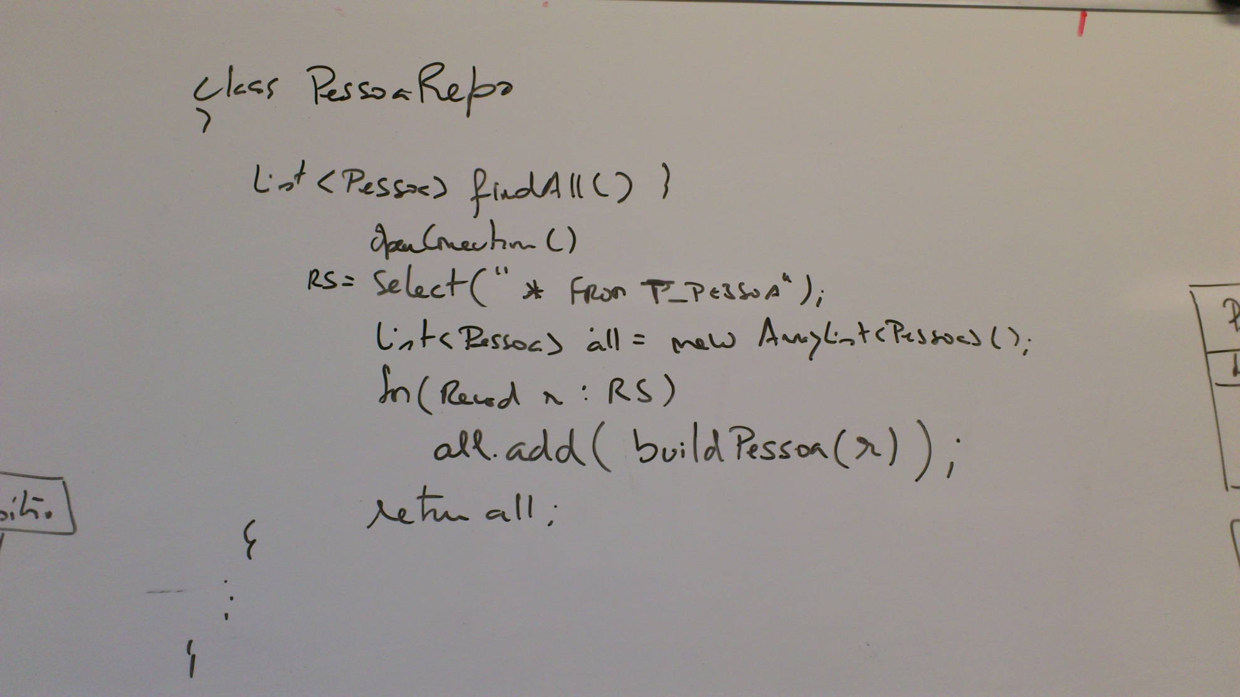
Domain model

Slide 6
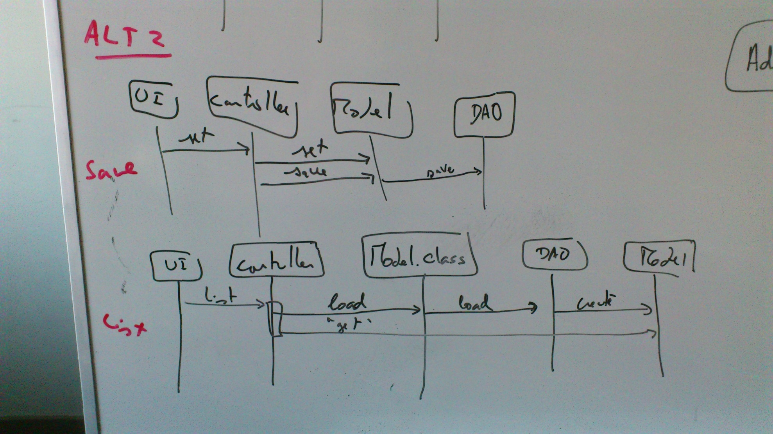
Active record

Slide 7
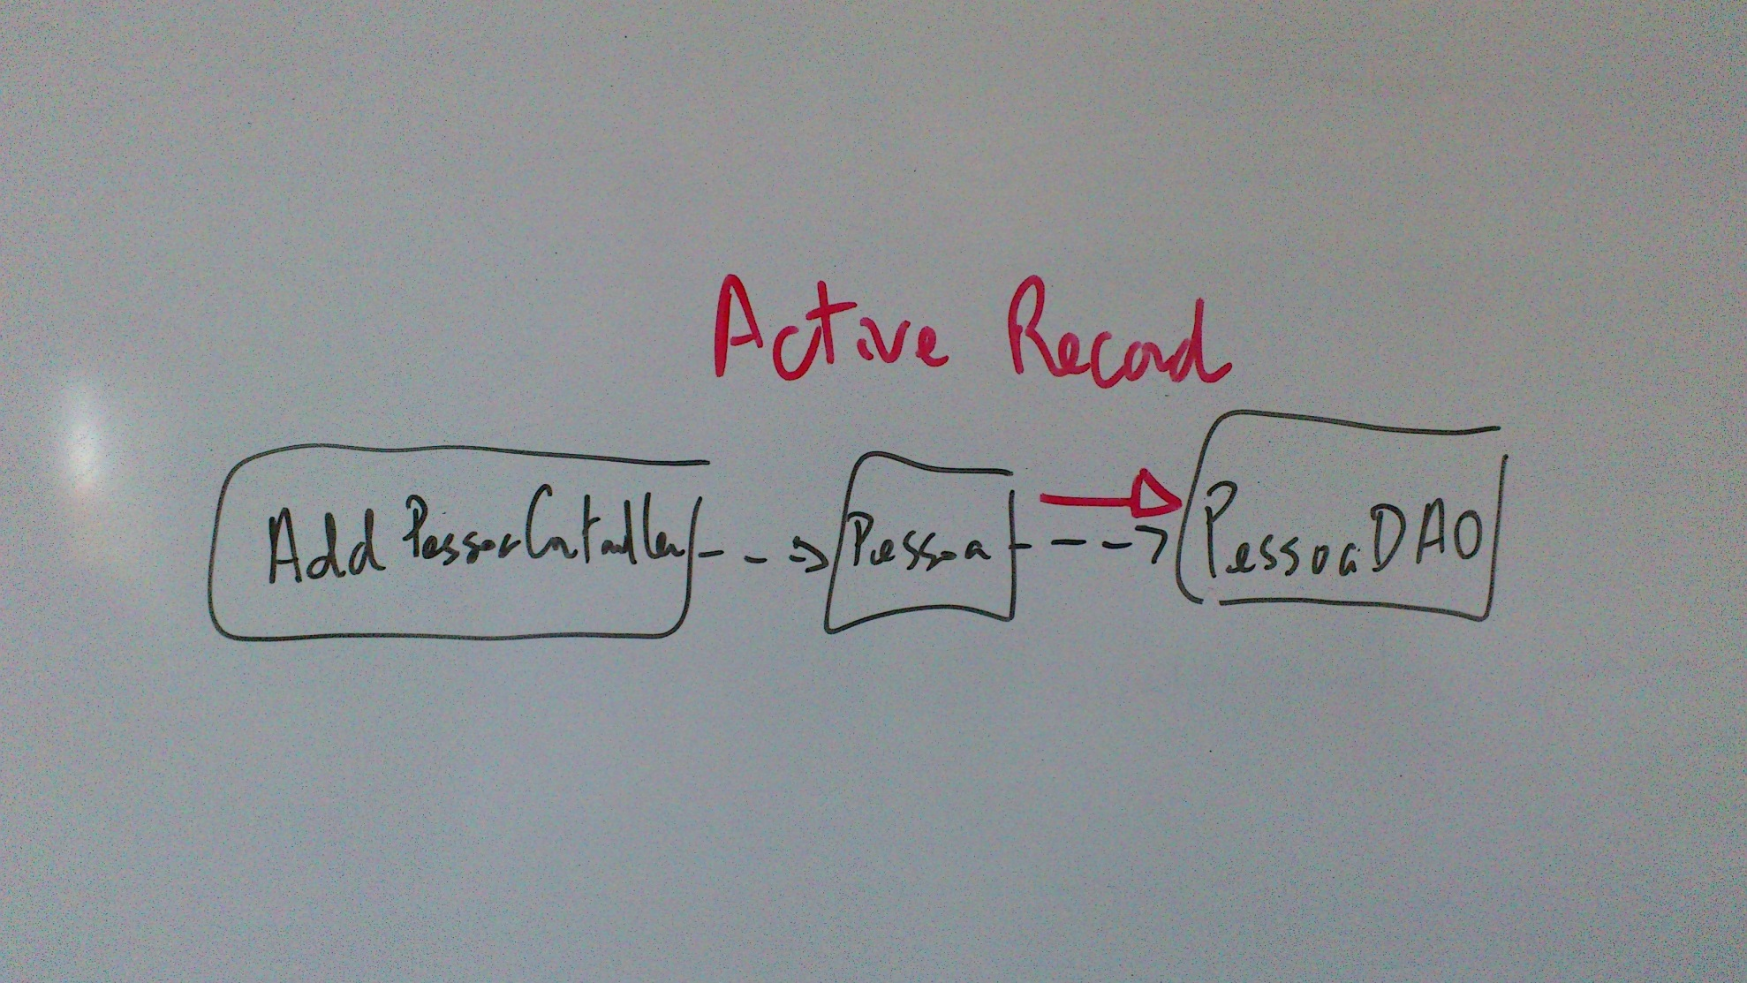
Active record

Slide 8
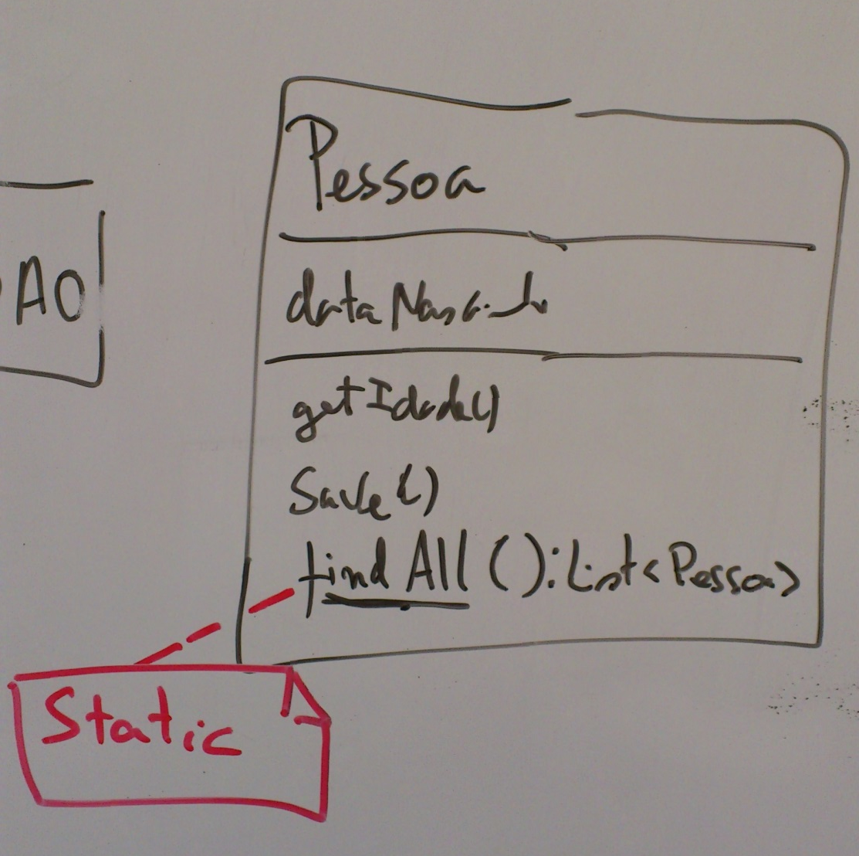
Active record

Slide 9
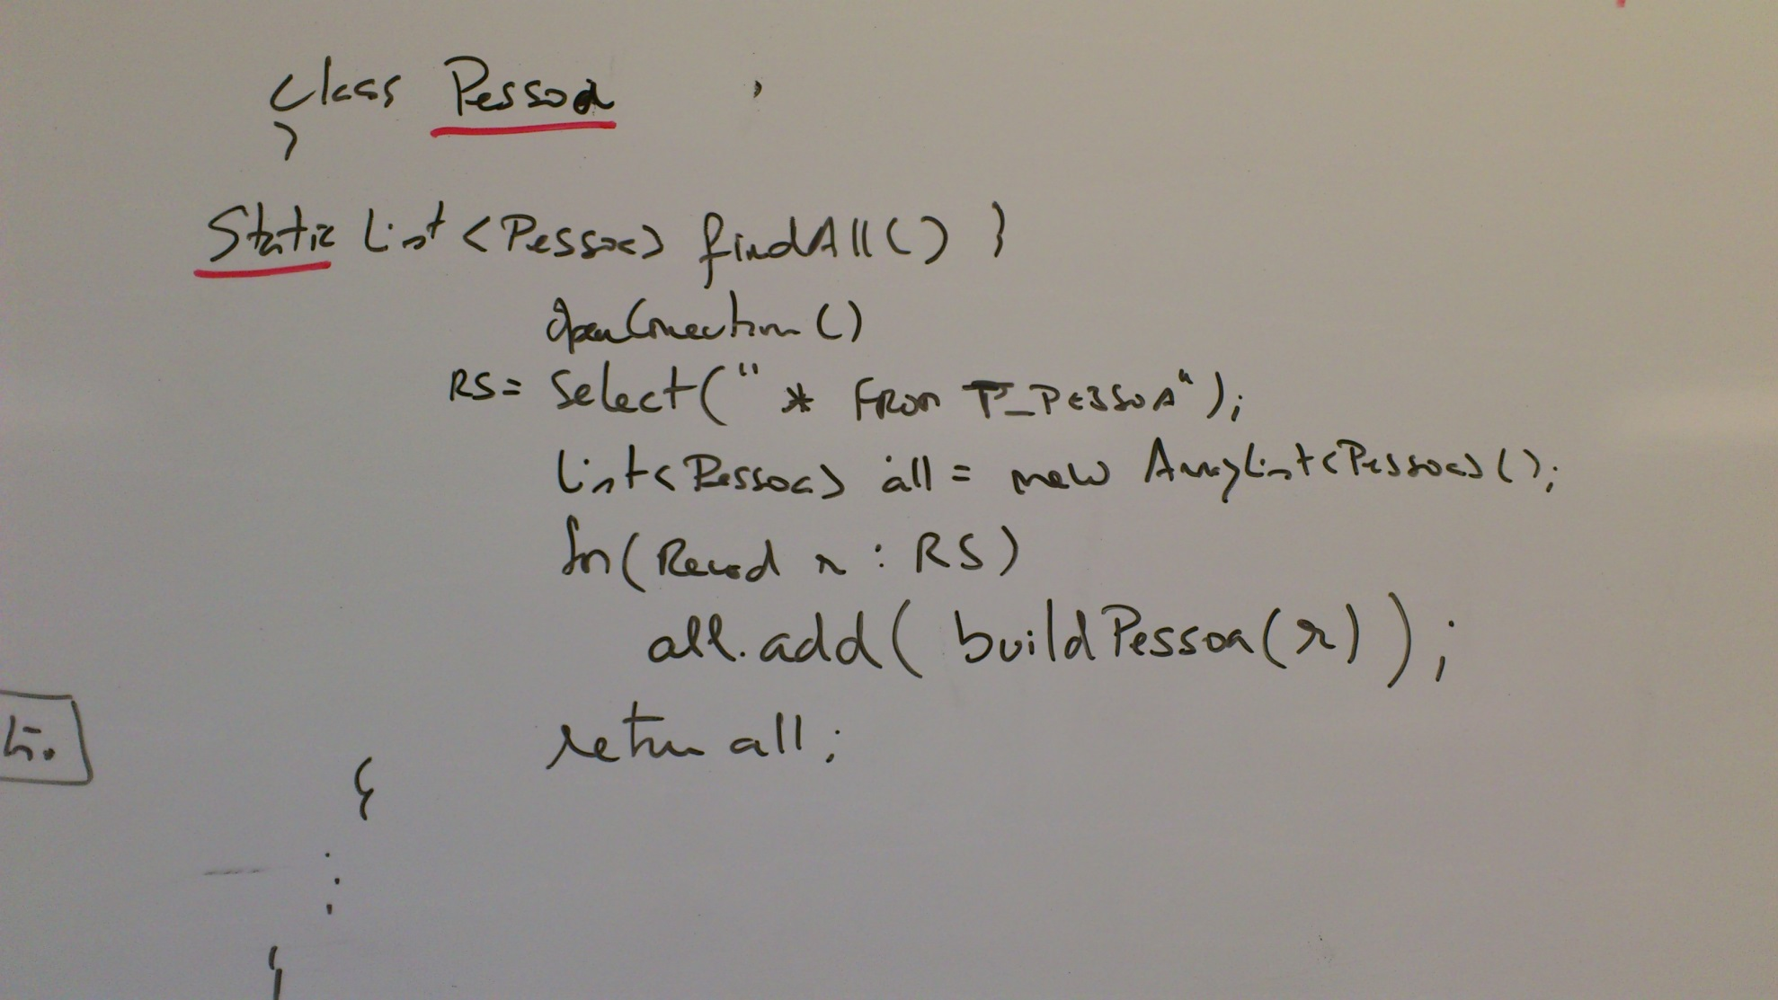
Active Record

